Slide 1
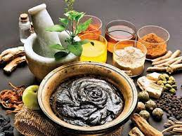
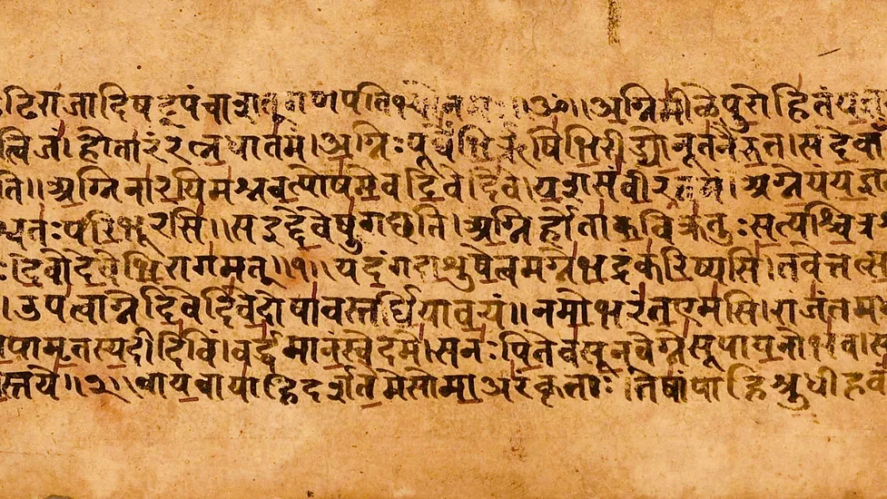
Traditional System of Medicines
Traditional medicine refers to health practices, approaches, knowledge and beliefs incorporating plant, animal and mineral based medicines, spiritual therapies, manual techniques and exercises, applied singularly or in combination to treat, diagnose and prevent illnesses or maintain well-being.
There is increased interest for search for new chemical entities and the expression of resistance of many drugs available in the market has lead to a shift in paradigm towards medicinal research.

Slide 2
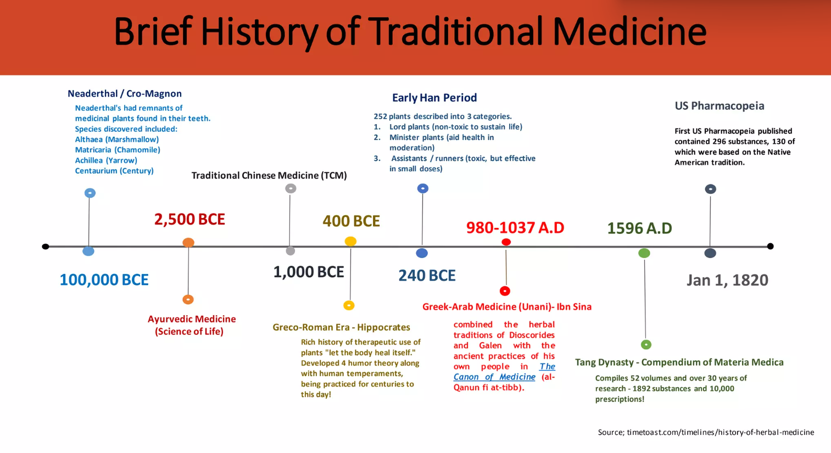
-history(2)-other continents
t

Slide 3
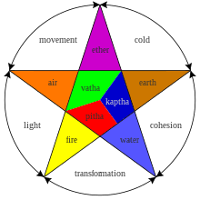
TRADITIONAL MEDICINAL KNOWLEDGE OF INDIA
Ayurveda System
'Preventive and Curative' measures are the key components of the Ayurvedic system
major approaches include use of 'anshadhi'(drugs) 'anna'(diet) and vihra that includes exercise and a healthy mode of life
The Charak samhita,Sushrut samhita and Samitha of Vaghbat together are referred to as the Brihattayee,the three classes of Ayurveda
Charak Samhita and Sushrut Samitha describes over 700 plants
Unanai System
The basis of the system of medicine were laid by Hippocrates and Galen,it was introduced in India by Arabs and Persians
Fundamental theory is 'humoral theory' which presupposes the presence of four humors-blood,phlegm,yellow bile and black bile in the body
the main therapeutic approaches in the system include dieto-therapy or 'llaj-bi-ghiza'(use of specific diet);regiment therapy or 'llaj-bil-tadbeer'(exercise,change of climate massage,venesection,leaching,cupping);pharmacotherapy or 'llaj-bi-dawa'(use of machines from herbal,mineral and other sources) and surgery or 'llaj-bil-yad'
Siddha System
Originated in Southern Part of India
"Siddhas" are believed to have developed this system which are written and mainly practiced in Tamil Nadu
Recognizes three humoral concepts-Vatta(wind),Pitta(bile),Kapha(phlegm)
Examination of the pulse,urine and different anatomical features like the tongue,voice,eyes,touch(to find dry,warm,cold,sweating condition) used as diagnostic criteria in Siddha medicines
‑Population using Traditional Medicine for Primary Healthcare:
Ethiopia-90%
India-70%
Rwanda-70%
Tanzania-60%
Uganda-60%
Population in developed countries who have complementary medicine at least once:
Canada-70%
Australia-48%
France-49%
USA-42%

Slide 4
Salient Features of Ayurveda
There are several aspects of this system of medicine which distinguish it from other approaches to health care:
1.Ayurveda describes three fundamental universal energies which regulate all natural processes on both the macrocosmic and microcosmic levels.That is, the same energies which produce effects in the various galaxies and star systems are operating at the level of the human physiology--in our own physiology. These three universal energies are known as the Tridosa.
2.Ayurveda is a complete medical system which recognizes that ultimately all intelligence and wisdom flows from one Absolute source (Paramatma).Health manifests by the grace of the Absolute, acting through the laws of Nature (Prakriti).Ayurveda assists Nature by promoting harmony between the individual and Nature by living a life of balance according to her laws.
3.It focuses on establishing and maintaining balance of the life energies within us,rather than focusing on individual symptoms.
4.It recognizes the unique constitutional differences of all individuals and therefore recommends different regimens for different types of people. Although two people may appear to have the same outward symptoms, their energetic constitutions may be very different and therefore call for very different remedies.

Slide 5
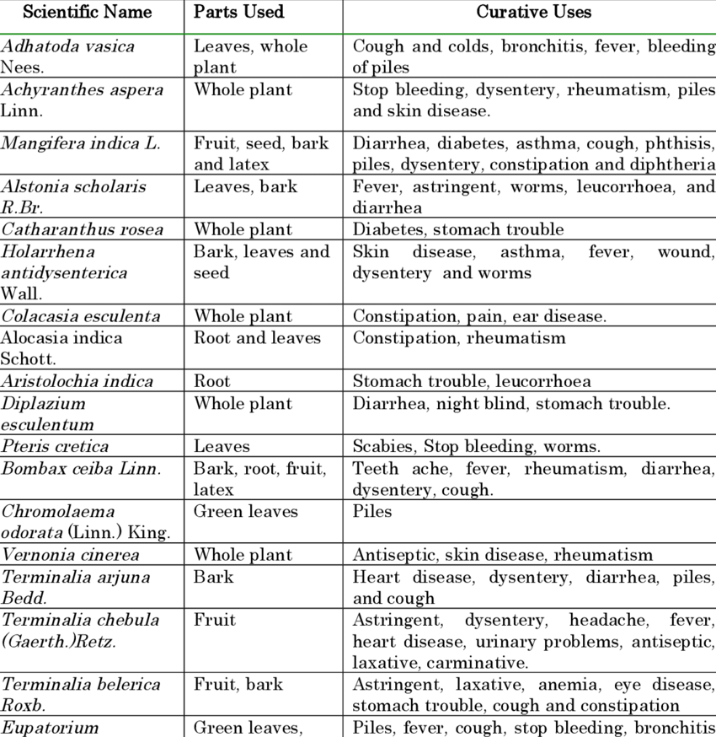
6.To balance the elements and the doshas of the body and the senses, there are many treatments, therapies, and exercises available. To balance the elements of the mind, meditations, mantra, and exercises are often used. Massage and rasayana treatments, along with visualization, pranic breathing, and other practices,allow personal access to intuition, and the innate knowledge of the soul.
7.Ayurveda believes five basic elements Pancamahabhutas (space,air,fire,water and earth) manifest in the human body as three basic humours known as tridosas(Vata,Pitta and Kapha). These three govern creation,maintenance and destruction of bodily tissues as well as the assimilation and elimination.Each person is born with a unique combination of these dosas which decides their basic constitution called Prakruti.Understanding of each person's Prakruti for deciding their personal diet and exercise pattern, supplements and medicinal herbs,cleansing and rebuilding therapies that is right for them are among the chief methods, Ayurveda employs for the maintenance and restoration of health.

Slide 6
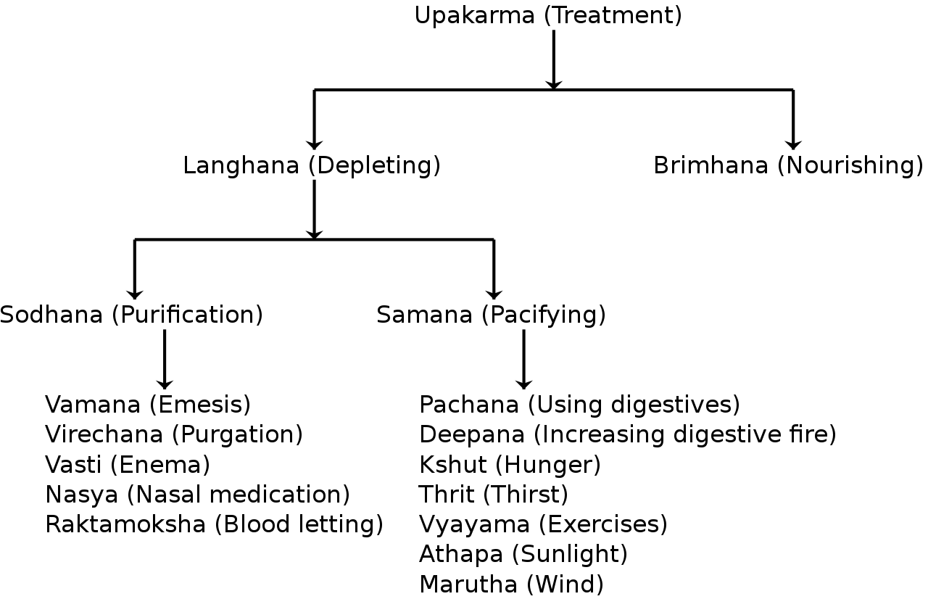
Digging Deep into Ayurveda
80 percent of people in India used Ayurveda exclusively or combined with conventional Western medicine. A 2014 national health survey found that, in general, forms of the Indian System of Medicine AYUSH(Ayurveda, Yoga and naturopathy, Unani, Sidha, and Homeopathy)
About 75%-80% of the population of Nepal use Ayurveda. As of 2009, Ayurveda was considered to be the most common and popular form of medicine in Nepal
In 1980, the Sri Lankan government established a Ministry of Indigenous Medicine to revive and regulate Ayurveda.In 2010, the public system had 62 Ayurvedic hospitals and 208 central dispensaries, which served about 3 million people (about 11% of Sri Lanka's population)
Outside Indian Subcontinent:Ayurveda is a system of traditional medicine developed during antiquity and the medieval period, and as such is comparable to pre-modern Chinese and European systems of medicine. In the 1960s, Ayurveda began to be advertised as alternative medicine in the Western world
In certain parts of the world, the legal standing of practitioners is equivalent to that of conventional medicine. Several scholars have described the contemporary Indian application of Ayurvedic practice as being "biomedicalized" relative to the more "spiritualized" emphasis to practice found in variants in the West.

Slide 7
Applications of Ayurvedic Herbs and Plants
Sr No. | Ayurvedic Drugs | Type of Formulation | Uses
1 | Khadirarishtha | Arishtha | Skin Diseases
2 | Triphala Churna | Churna | General Tonic, Stomach Ache
3 | Parad Bhasma | Bhasma | Anitdiarrhoeal
4 | Shatavari Ghruta | Ghruta | Piles
5 | Medohar Vati | Vati | Hypolididemic
6 | Chirayata Arka | Arka | Antipyretic
7 | Adulasa Kshar | Kshar | Expectorant
8 | Dashmukha Qwath | Qwath | Ailments of Kapha and Vata
Branches of Ayurveda
Kaya Chikitsa- Medicine.
Shalya Tantra- Surgery.
Shalakya Tantra- ENT and Opthalamology.
Kaumarbhritya- Paediatrics and Obstretics.
Agad Tantra- Toxicology.
Bhut Vidya- Psychiatry.
Rasayan- Rejuvenation therapy and geriatrics.
Vajikaran- Sexology

Slide 8
Surgery in Ancient India
The ancient surgical science was known as Shalya Tantra. Shalya means broken arrow or a sharp part of a weapon and Tantra means maneuver. Shalya Tantra embraces all processes, aiming at the removal of factors responsible for producing pain or misery to the body or mind. Since warfare was common then, the injuries sustained led to the development of surgery as refined scientific skill.
All the four Vedas contain detailed descriptions of teachings and practice of the great ancient surgeon Sushruta and has considerable surgical knowledge of relevance even today.
Sushrutaa Samhita deals mainly with surgical knowledge. Complicated surgeries such as cesarean, cataract, artificial limb, fractures, urinary stones plastic surgery, and procedures including per- and post-operative treatment along with complications written in Sushrutaa Samhita, which is considered to be a part of Atharva Veda, are surprisingly applicable even in the present time.
Sushruta has described surgery under eight heads: Chedya (excision), Lekhya (scarification), Vedhya (puncturing), Esya (exploration), Ahrya (extraction), Vsraya (evacuation), and Sivya (suturing).
All the basic principles of surgery such as planning precision, hemostasis, and perfection find important places in Sushruta's writings on the subject. He has described various reconstructive procedures for different types of defects.
He describes 60 types of upkarma for treatment of wound, 120 surgical instruments and 300 surgical procedures, and classification of human surgeries in eight categories.For successful surgery, Sushruta induced anesthesia using intoxicants such as wine and henbane (Cannabis indica).
He treated numerous cases of Nasa Sandhan (rhinoplasty), Oshtha Sandhan (lobuloplasty), Karna Sandhan (otoplasty). Even today, rhinoplasty described by Shushruta in 600 BC is referred to as the Indian flap and he is known as the originator of plastic surgery.

Slide 9
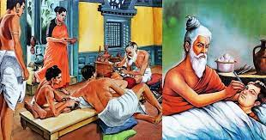
Besides trauma involving general surgery, Sushruta gives an in-depth account and a description of the treatment of 12 varieties of fracture and six types of dislocation. He mentions the principles of traction, manipulation, apposition, stabilization, and postoperative physiotherapy.
Plastic surgery and dental surgery were practiced in India even in ancient times. Students were properly trained on models. New students were expected to study for at least 6 years before starting their training. He taught his surgical skills to his students on various experimental models. Incision on vegetables such as watermelon and cucumber, probing on worm-eaten woods, preceding present-day workshop by more than 2000 years are some instances of his experimental teachings. He was one of the first people in human history to suggest that a student of surgery should learn about human body and its organ by dissecting a dead body.
Sushrutaa Samhita remained preserved for many centuries exclusively in the Sanskrit language. In the eight century AD, Sushrutaa Samhita was translated into Arabic as “Kitab Shah Shun al –Hindi” and “Kitab – I – Susurud.” The first European translation of Sushrutaa Samhita was published by Hessler in Latin and in German by Muller in the early 19th century; the complete English literature was done by Kaviraj Kunja Lal Bhishagratna in the three volumes in 1907 at Calcutta.
Ancient Dentistry: The Indus Valley civilisation (IVC) has yielded evidence of dentistry being practised as far back as 7000 BCE. An IVC site in Mehrgarh indicates that this form of dentistry involved curing tooth related disorders with bow drills operated, perhaps, by skilled bead crafters
He described six varieties of accidental injuries encompassing all parts of the body. They are described below:
=Chinna - Complete severance of a part or whole of a limb
=Bhinna - Deep injury to some hollow region by a long piercing object
=Viddha Prana - Puncturing a structure without a hollow
=Kshata - Uneven injuries with signs of both Chinna and Bhinna, i.e., laceration
=Pichchita - Crushed injury due to a fall or blow
=Ghrsta - Superficial abrasion of the skin.

Slide 10
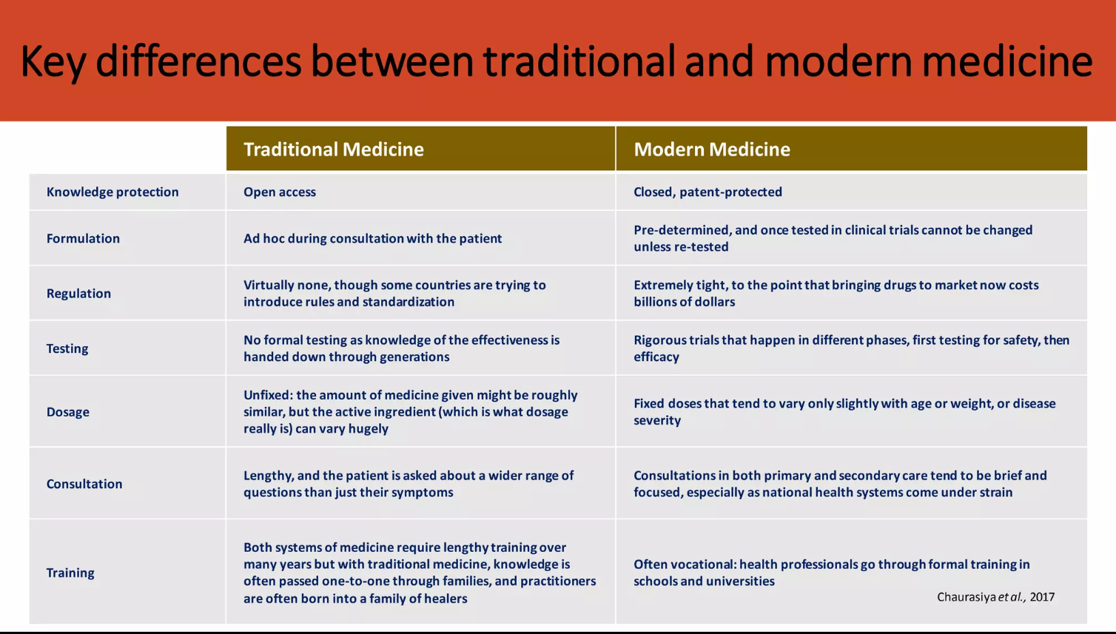
-traditional vs modern/specific medcines currently who red cross(resarch)

Slide 11
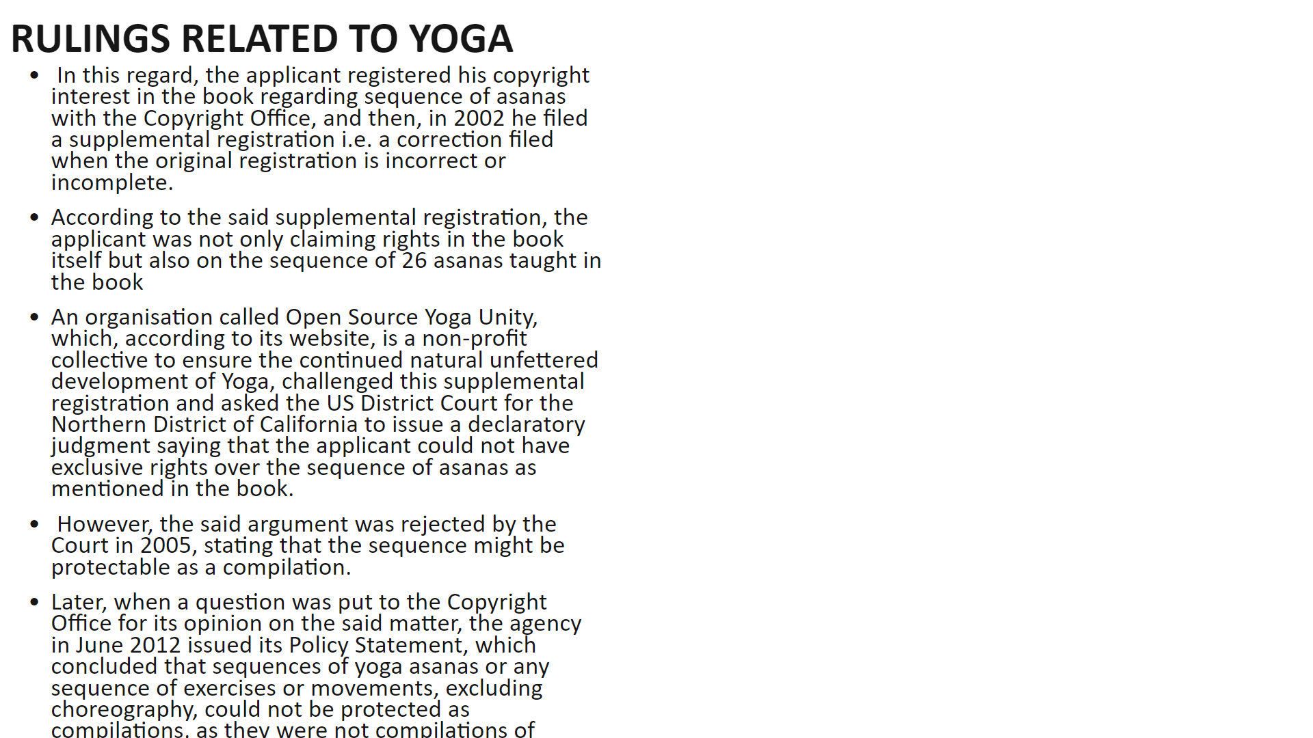
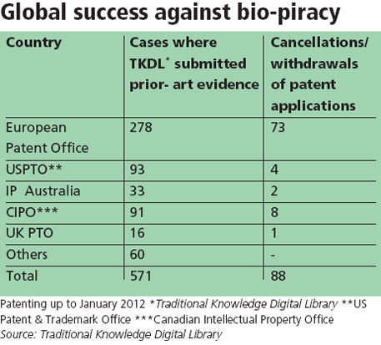
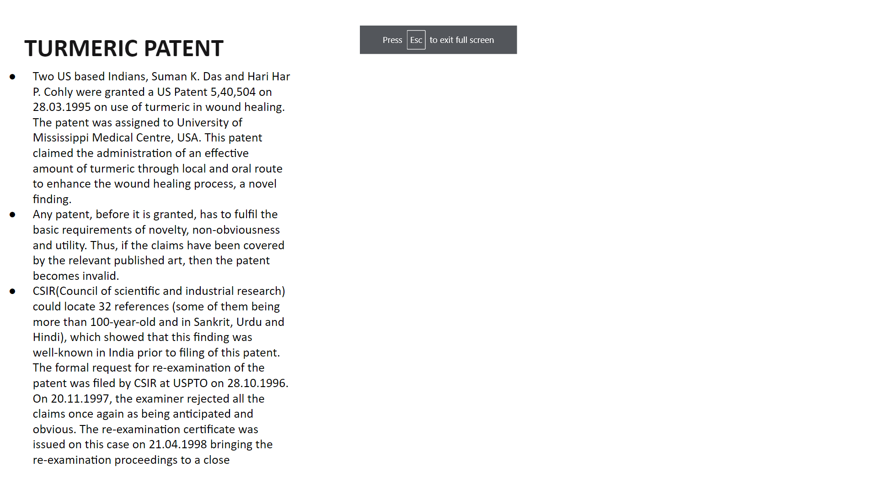
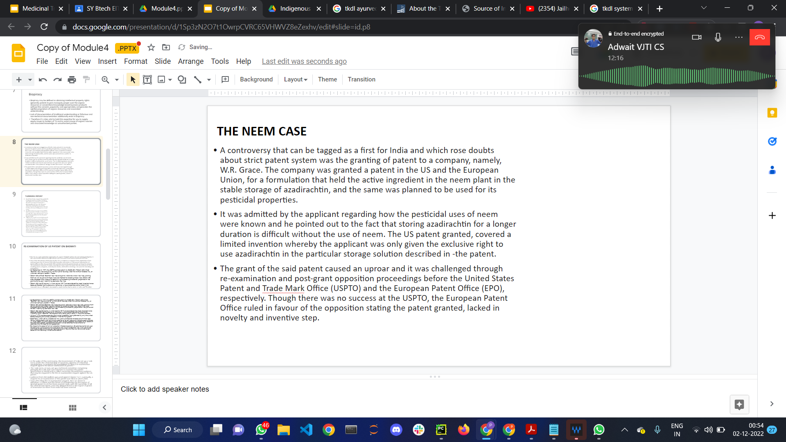
TKDL
Discipline | Number of Texts used for transcription | Formulations | Language
Ayurveda | 119 | 80,000 | Sanskrit,Hindi
Unani | 55 | 1,000,000 | Arabic Urdu Persian
Siddha | 91 | 12,000 | Tamil
Yoga | 15 | 3,000 | Sanskrit,Hindi
Total | 270+ | 4.2 lakhs+
traditional knowledge from the existing literature existing in local languages
such as Sanskrit, Urdu, Arabic, Persian and Tamil in converted into digitized format,and is available in five international languages including English, German, Spanish,French and Japanese.
Limitations of TKDL
-TKDL is a defensive technical Tool,access to TKDL is limited to International Patent Offices(US,UK, Germany,Canada,Australia,Russia,EPO)
-It can protect only its content which at present are limited to open domain codified knowledge for indian system of medicine
-Its not a substitute for an international legally binding instrument for protection of traditional traditional knowledge rather it would compliment such a system as and when its established
-In addition to International legally binding instrument databases such as TKDL international system needs to evolve practical guidelines which can help examiners in asserting the novelty and inventive step
At Least 36 cases had been identified by the EPO and 40 cases by USPTO, using TKDL

Slide 12
TKDL Cntd.
Traditional Knowledge Resource Classification (TKRC), an innovative structured(under section, class, subclass, group and subgroup) classification system for the purpose of systematic arrangement, dissemination and retrieval was evolved for about 5,000 subgroups against few subgroups related to medicinal plants.
Each text is read, medicinal formulation/ practice identified and converted into a structured language using TKRCby experts
The codes are then filled into the data entry screen. The content (prior art) from ancient texts are also saved in the database.The translated version of all the TKRC codes is ported in the database.The codes once saved in meta data directory are converted in different languages based on Unicode technology.
The converted format of the formulation is readable and can be understood in general by all in any of the five langugaes (English, German, French Japanese and Spanish languages.)
Traditional terminology is also converted into modern terminology, for example, Jwar to fever, Turmeric to Curcuma longa, Mussorika to small pox etc.
TKDL includes a search interface providing full text search and retrieval of traditional knowledge information on IPC and keywords in multiple languages.
It includes single or multiple word searches, complex Boolean expression search, Proximity search, Field search, Phrase search, etc in the form of simple and advance search options.
TKDL acts as a bridge between formulations existing in local languages and a Patent Examiner at a global level, since the database will provide information on modern as well as local names in a language and format understandable to Patent Examiners.

Slide 13
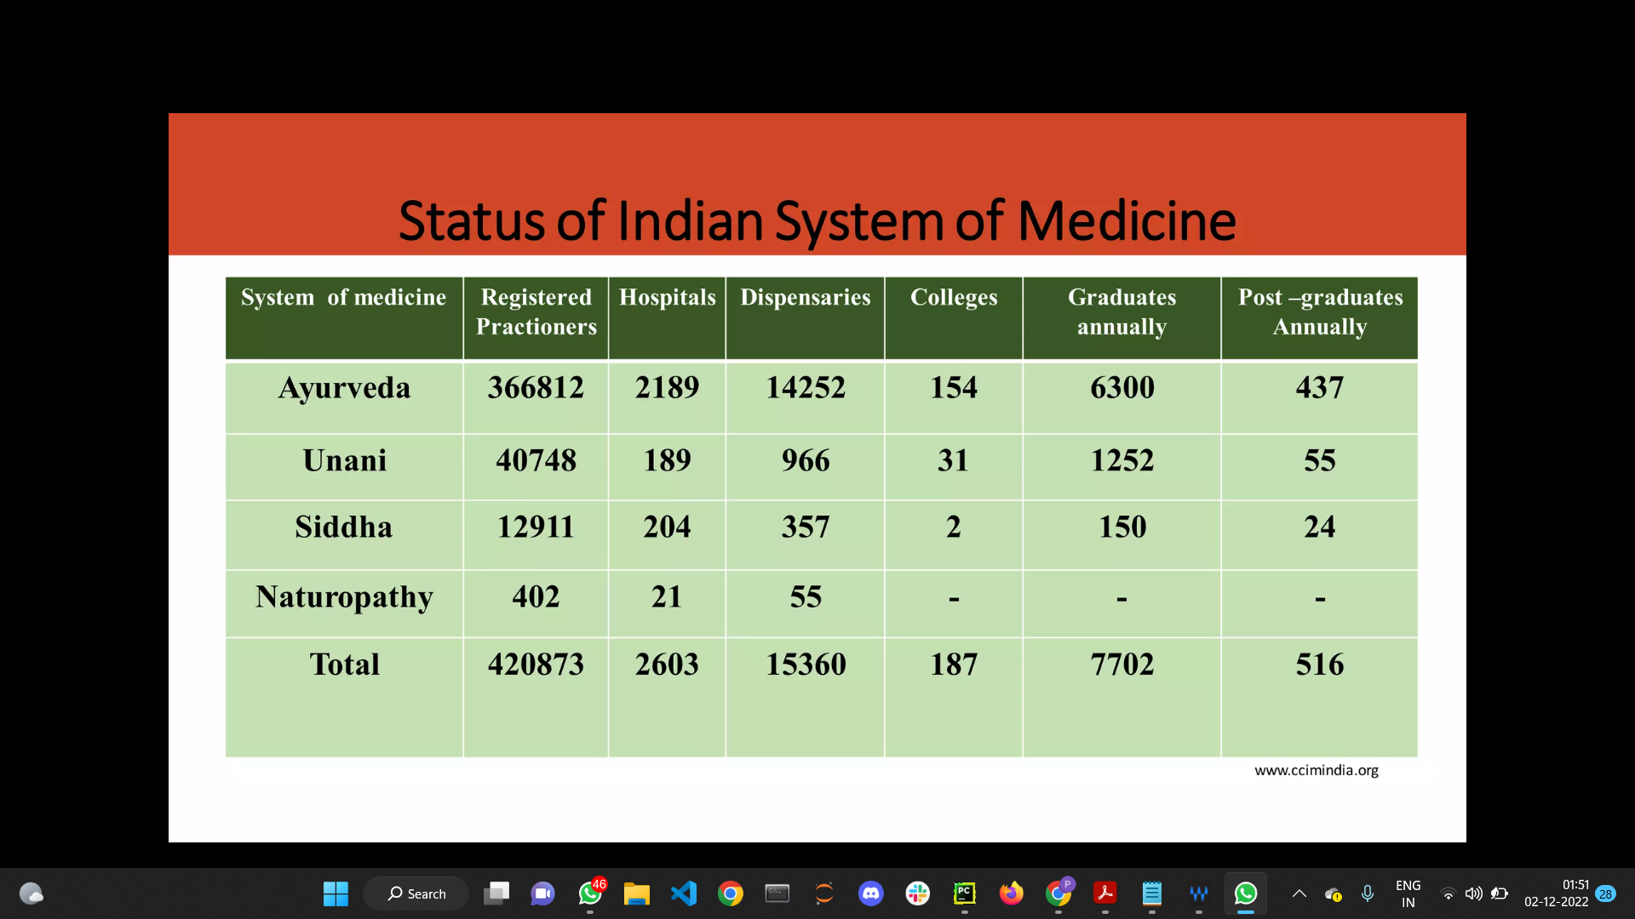
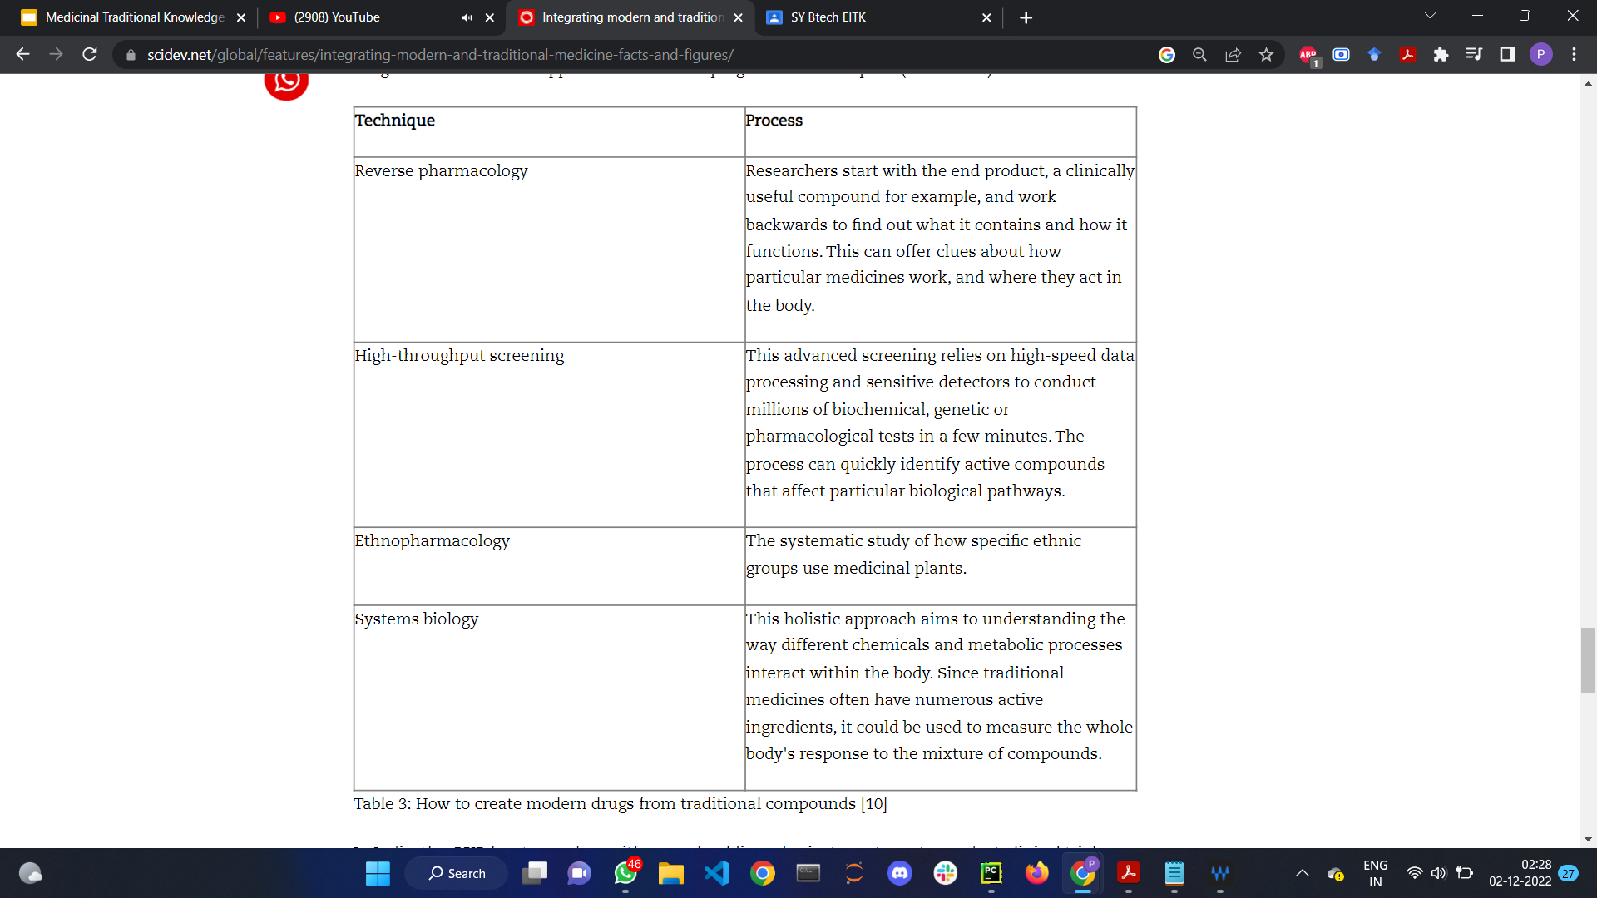
Modern Research Using Traditional Medicinal Knowledge
Ministry of AYUSH-CENTRAL COUNCIL FOR RESEARCH IN AYURVEDIC SCIENCES
-Tribal Health Care Research Programme:
provide health care facilities at door step of tribal people. Under Tribal Health Care Research a total population 8,42,959 of 1003 villages have been covered.
-Swasthya Rakshan Programme:
Through this programme health care facilities and awareness will be provided to 5 colonies/villages in selected states.
-Ayurveda Mobile Health Care Programme under Scheduled Castes Sub Plan (SCSP):
Through this programme, door to door health care facilities will be provided to the areas with SC pockets.
-NPCDCS Programme:
for prevention and control of non communicable diseases(cardiovascular disease and stroke,cancer,diabetes) in 3 identified districts of 3 states
Pharmacology Research:
Pharmacological studies of Ayurvedic drugs/ formulations & their safety/toxicity study of drugs present in the database on medicinal plants
Clinical Research:
Validation and development of formulations for disease/clinical conditions improving quality of life in cancer patients, Mental Retardation, geriatric health.
Ayurveda:CNN model to classify medicinal plants based on leaf structures ,data samples:40 plants using softmax and svm classifier
A Deep Learning based Approach for Identifying Medical Uses of plant derived natural
supervised learning based models to utilize heterogeneous features to alleviate incomplete information
IMPPAT: A curated database of Indian Medicinal Plants,Phytochemistry And Therapeutics study on structure,absorption,distribution,metabolism, excretion, toxicity of dtugs harvested from various sources like TKDL,FDA Drug Base etc.
Chemogenomics approaches to rationalising compound action of traditional Chinese and Ayurvedic medicines

